Slide 1
Healthy Workplaces for All Ages
Promoting a sustainable working life

Slide 2
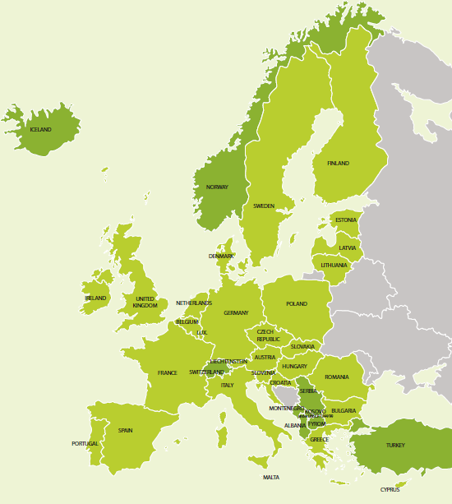
Introduction to the campaign
Coordinated by the European Agency for Safety and Health at Work (EU-OSHA)
Organised in more than 30 countries
Supported by a network of partners:
  National focal points
  Official campaign partners
  European social partners
  Media partners
  Enterprise Europe Network
  EU institutions
  Other EU agencies

Slide 3


Key objectives
Promote sustainable work and healthy ageing from the beginning of working life
Highlight the importance of prevention throughout working life
Assist employers and workers (including in SMEs) by providing information and tools for managing OSH in the context of an ageing workforce
Facilitate information exchange and good practice

Slide 4
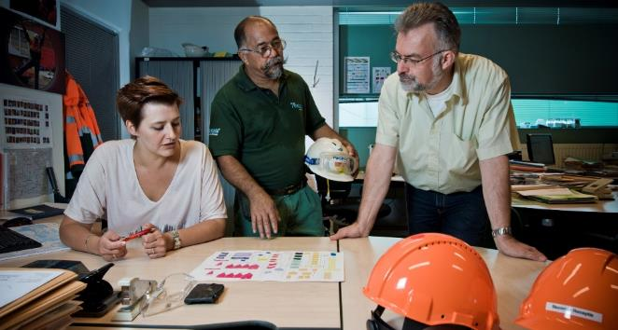
What is the issue?
Europe’s workforce is ageing — longer working lives
Challenges arising from demographic change:
  general labour shortages
  shortages of skilled workers
  more people at work with health problems/chronic diseases
  concerns about productivity and absenteeism
Management of OSH in the context of an ageing workforce requires a multidisciplinary approach...

Slide 5

Prevention throughout working life — holistic approach
Health in later life is affected by working conditions in earlier life
Prevention of work-related accidents, health problems and occupational diseases is needed throughout working life
Holistic approach, including:
  work environment and organisation
  training and lifelong learning
  leadership
  work–life balance
  motivation
  career development

Slide 6
Work ability concept
Work ability concept — balance between work demands and individual resources
Work demands affected by:
  work content, workload, work organisation
  working environment and community
  leadership
Individual resources dependent on:
  health and functional capacities
  skills and competences
  values, attitudes, motivation
Promoting work ability requires:
  good leadership
  worker participation
  cooperation between management and workers
Work ability index

Slide 7
Diversity-sensitive risk assessment
Risk assessment is the cornerstone of
OSH management in Europe
Differences exist between individuals, take account of:
  age
  gender
  disability
  migrants
For younger workers, take account of:
  physical and intellectual development
  immaturity
  lack of experience
For older workers, consider:
  high-risk situations (e.g. shift work, high physical workload,
  extreme temperatures)
Older workers are not a homogeneous group and differences
in both functional capacity and health between individuals
increase with age
Diversity addressed by focusing on work demands
in relation to individual capacities and health

Slide 8
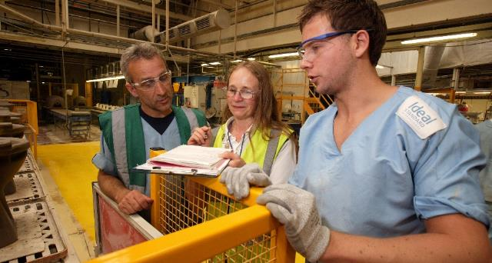
Adapting the workplace
Work should be adapted to individual abilities, skills and health status, as well as other factors of diversity
Dynamic and continuous process throughout working life
Examples of changes in response to functional capacity:
  use of equipment
  good ergonomic design
  job re-design
  job rotation
Good workplace design and good organisation benefit all ages

Slide 9

Disability prevention, rehabilitation and return to work
Work is good for health provided that working conditions are decent
Long-term sick leave can lead to mental health issues
Health issues most common reason for leaving workforce early
Important to help people with health problems remain in work through rehabilitation and return to work
Good examples:
  ‘sick note’ replaced by ‘fit note’ — UK
  ‘return to work’ intervention project — Denmark
  ‘fit2work’ programme — Austria

Slide 10

Lifelong learning
Enable workers of all ages
to take part in education and training
Prevent erosion of
skills and competences
Updating and developing skills
important for employability
Also important for
psychosocial working environment

Slide 11
Workplace health promotion
Combined efforts of employers, employees and
society to improve health and well-being at work
Can be only successful if combined with risk prevention
and health protection
‘Health promoting workplaces’ – a comprehensive approach, integrating OSH and health protection with health promotion, addressing both work organisation and work environment
issues and the individual risk factors.

Slide 12
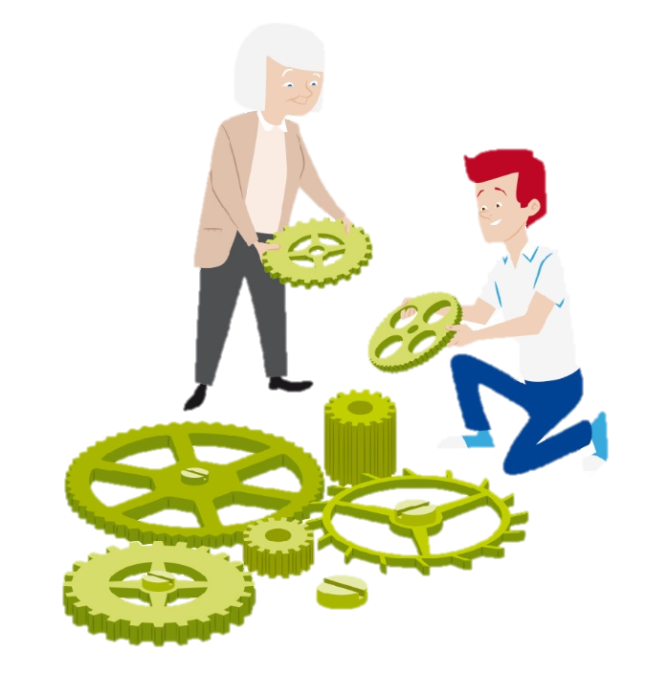
Human resources (HR) and OSH management
Cooperation between stakeholders is very important, particularly HR and OSH management
HR policies have an impact on safety and health, for example:
  work–life balance
  working time
  lifelong learning
  career development
HR should support OSH management of all ages

Slide 13
What are the benefits?
Improve health and well-being of employees:
  working is good for physical and mental health
  health of workers of all ages can be improved
Improve productivity and cost-effectiveness at organisational level:
  healthy, productive and motivated workforce — organisation remains competitive and innovative
  valuable skills and experience retained within organisation
  lower rates of sick leave and absenteeism — lower work disability costs
  lower staff turnover
  greater well-being at work, with employees achieving their potential

Slide 14

Getting involved
Organisations of all sizes and sectors, as well as individuals, can get involved
Get involved by:
  disseminating campaign materials
  taking part in or organising events and activities
  using and promoting age-management tools
  becoming a partner of the campaign
  keeping up to date via social media

Slide 15

Key dates
Campaign launch:
April 2016
European Weeks for Safety and Health at Work:
October 2016 and 2017
Healthy Workplaces Good Practice Awards Ceremony:
April 2017
Healthy Workplaces Summit:
November 2017

Slide 16
Campaign partnership offer
Successful partnerships between EU-OSHA
and key stakeholders are crucial for the success
of the campaign
Pan-European and international organisations
can become official campaign partners
Benefits include:
  a welcome pack
  a partner certificate
  special category for partners in the Healthy Workplaces
  Good Practice Awards
  promotion at EU level and in the media
  networking opportunities and exchange of
  good practice with other campaign partners
  invitation to EU-OSHA events

Slide 17
Healthy Workplaces Good Practice Awards
Recognition of innovative safety and health practices in the workplace
Organisations are rewarded for successful and sustainable initiatives promoting healthy workplaces for all ages
Open to organisations in:
  EU Member States
  candidate countries
  potential candidate countries
  European Free Trade Association (EFTA)
Two stages:
  National level — focal points nominate national winners
  European level — official campaign partners and national winners
Winners announced at the awards ceremony

Slide 18





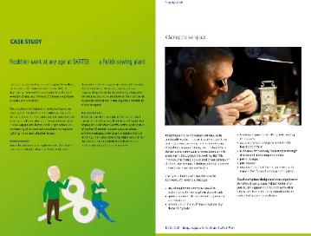
Campaign resources
Campaign guide
Practical e-guide
Promotion material
  Campaign leaflet
  Good Practice Awards flyer
  Poster
  Video
  Infographics
  Online banner, Email signature
Napo film
Materials from ‘Safer and healthier work at any age’ (European Parliament pilot project)
Module for Online interactive Risk Assessment (OiRA)
Reports

Slide 19




Further information
Learn more at the campaign website:
www.healthy-workplaces.eu
Subscribe to our campaign newsletter:
https://healthy-workplaces.eu/en/healthy-workplaces-newsletter
Keep up to date with activities and events through social media:
Find out about events in your country from your focal point: www.healthy-workplaces.eu/fops

