Slide 1
Prevention and management of work-related musculoskeletal disorders
Healthy Workplaces Campaign 2020-22
LIGHTEN THE LOAD

Slide 2

Overview
What is the problem?
Parts of the body typically affected by MSDs
What are work-related MSDs?
Tackling MSDs
Risks and prevention
EU-OSHA and campaign partners
Campaign tools and resources
How to get involved

Slide 3
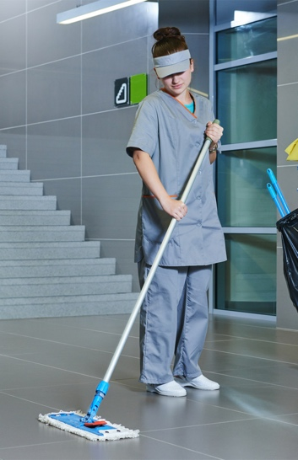
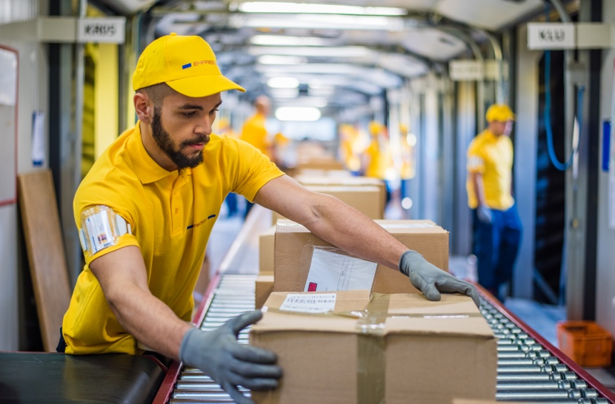


EU-OSHA, ESENER 2019
What is the problem?
©iStockphoto / kadmy
©iStockphoto / simonkr
3 of the 4 most frequently identified OSH risk factors are MSD risks:
repetitive hand or arm movements
prolonged sitting
lifting or moving people or heavy loads
©iStockphoto / Image Source
©iStockphoto / Jacob Ammentorp Lund
Notes:
Source: EU-OSHA, ‘Third European Survey of Enterprises on New and Emerging Risks (ESENER 3), 2019. Available at: https://osha.europa.eu/en/publications/third-european-survey-enterprises-new-and-emerging-risks-esener-3/view

Slide 4
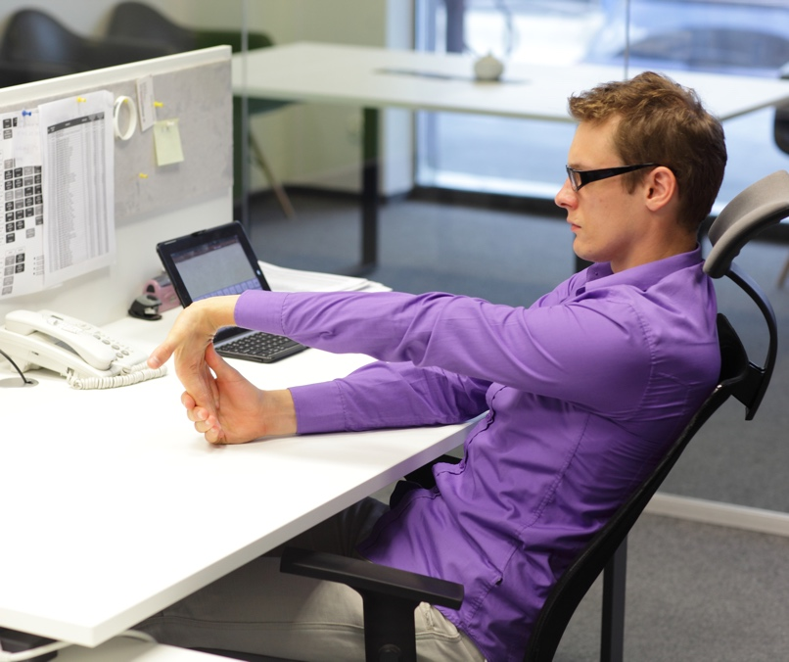
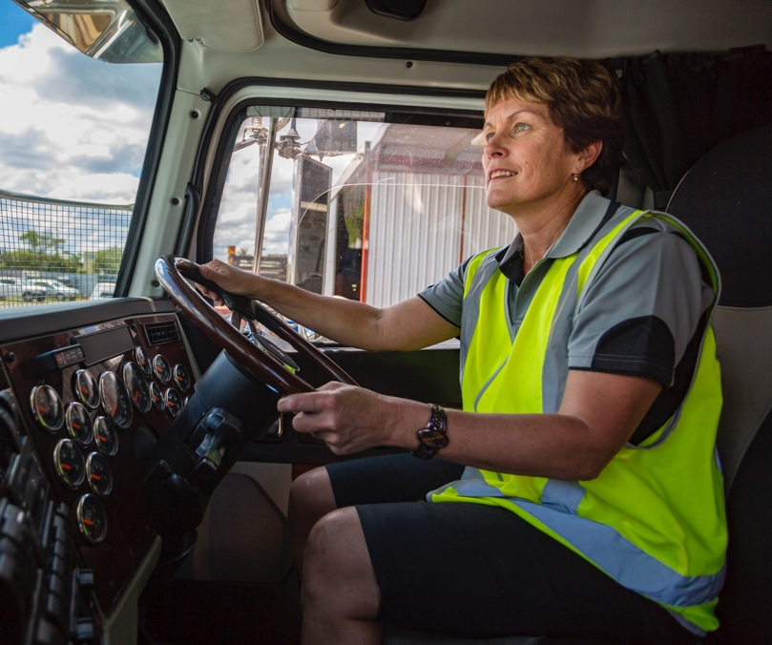
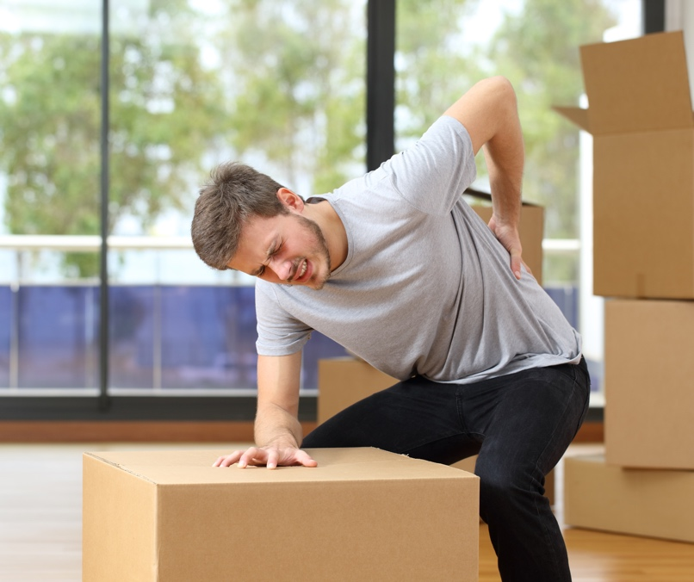
EWCS 2015
What is the problem?
Roughly 3 in every 5 workers in the EU report MSD complaints
©iStockphoto / endopack
©iStockphoto / davidf
©iStockphoto / AntonioGuillem
Notes:
Source: EU-OSHA, `Work-related musculoskeletal disorders: prevalence, costs and demographics in the EU´, 2019, p. 45 . Available at:
https://osha.europa.eu/en/publications/msds-facts-and-figures-overview-prevalence-costs-and-demographics-msds-europe/view
In 2015, approximately three out of every five workers in the EU-28 reported MSD complaints in the back, upper limbs and/or lower limbs. This can be concluded from the sixth wave of the EWCS. The most common MSD types among workers in the EU-28 are backache and muscular pains in the upper limbs (43 % and 41 %, respectively, in 2015). Muscular pains in lower limbs are reported less often (29 % in 2015). More information about Eurofound - ‘Sixth European Working Conditions Survey’ (EWCS), 2015. Available at: https://www.eurofound.europa.eu/surveys/european-working-conditions-surveys/
sixth-european-working-conditions-survey-2015

Slide 5

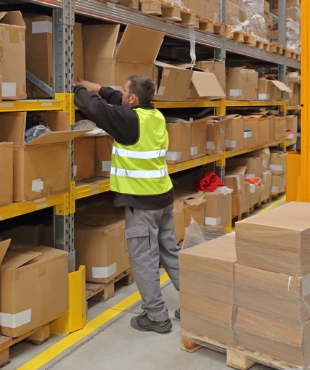

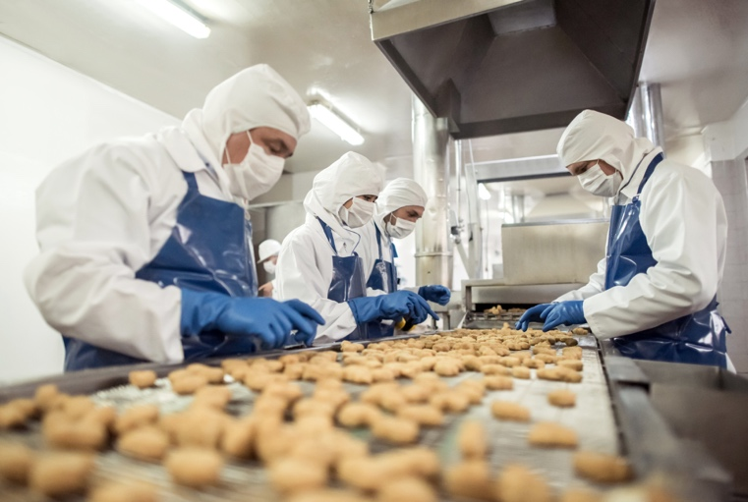
Eurostat, Labour Force Survey 2013
What is the problem?
Of all workers in the EU with
a work-related health problem,
60 % identify MSDs
as the most serious
©iStockphoto / SDI Production
©iStockphoto / Baloncici
©iStockphoto / zoranm
©iStockphoto / andresr
Notes:
Source: Eurostat, Labour Force Survey ad hoc module ‘Accidents at work and other work-related health problems’, 2013. Available at: https://ec.europa.eu/eurostat/statistics-explained/index.php/EU_labour_force_survey_-_ad_hoc_modules

Slide 6

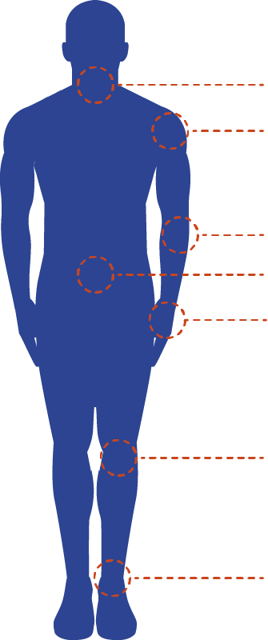
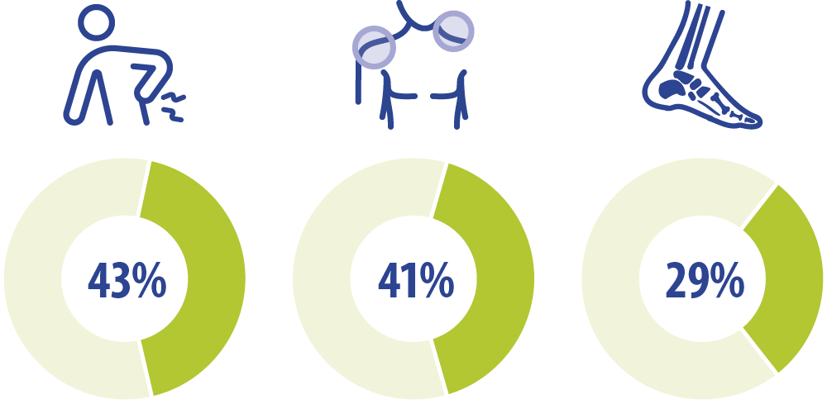
Parts of the body typically affected
Neck
Shoulders
Elbows
Back
Wrists /
Hands
Knees
Back
Upper limbs
Lower limbs
Ankles / Feet
Notes:
Percentage of workers reporting different musculoskeletal disorders in the past 12 months, EU-28, 2015. Source: Sixth European Working Conditions Survey (2015)
EU-OSHA, `Work-related musculoskeletal disorders: prevalence, costs and demographics in the EU´, 2019, p. 45 . Available at:
https://osha.europa.eu/en/publications/msds-facts-and-figures-overview-prevalence-costs-and-demographics-msds-europe/view
The most common MSD types among workers in the EU-28 are backache and muscular pains in the upper limbs (43 % and 41 %, respectively, in 2015). Muscular pains in lower limbs are reported less often (29 % in 2015). Based on ‘Sixth European Working Conditions Survey’ (EWCS), 2015. Analysis carried out by EU-OSHA. More information about this survey available at: https://www.eurofound.europa.eu/surveys/european-working-conditions-surveys/
sixth-european-working-conditions-survey-2015

Slide 7
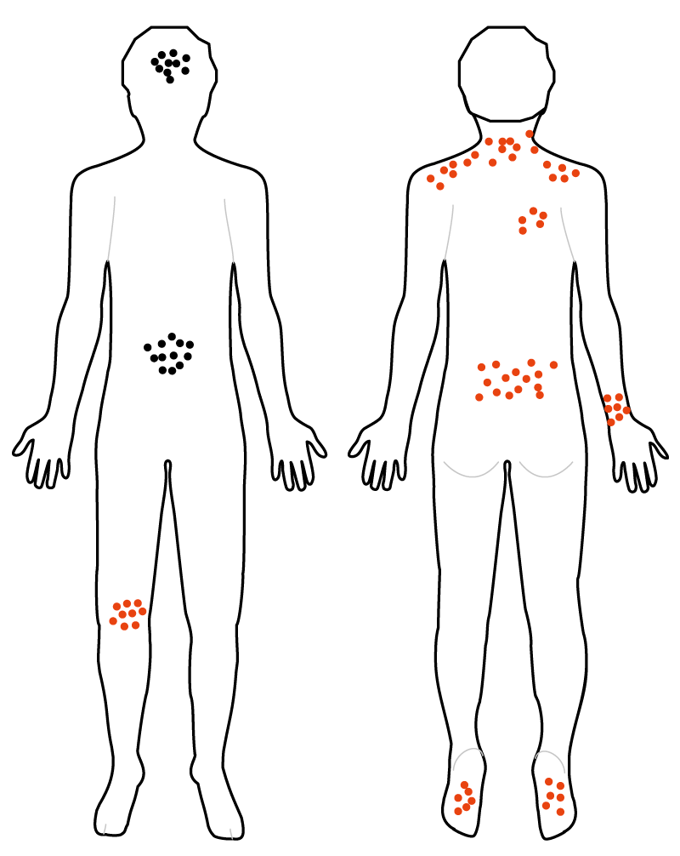
What are work-related MSDs?
Impairments of
bodily structures
Caused or aggravated primarily by work
Physical, psychosocial, organisational and individual factors can contribute
Aches and pains
Stress symptoms
Front
Back
Notes:
Work-related musculoskeletal disorders (WR-MSDs) are impairments of bodily structures, such as:
muscles
joints
tendons
ligaments
nerves
bones
the localised blood circulation system.
WR-MSDs are caused or aggravated primarily by work and by the effects of the immediate environment in which work is carried out.
Physical, psychosocial, organisational and individual factors can contribute to the development of WR-MSDs.
EU-OSHA, 2007. ‘Factsheet 71 — Introduction to work-related musculoskeletal disorders’ (available at https://osha.europa.eu/en/tools-and-publications/publications/factsheets/71/view).

Slide 8

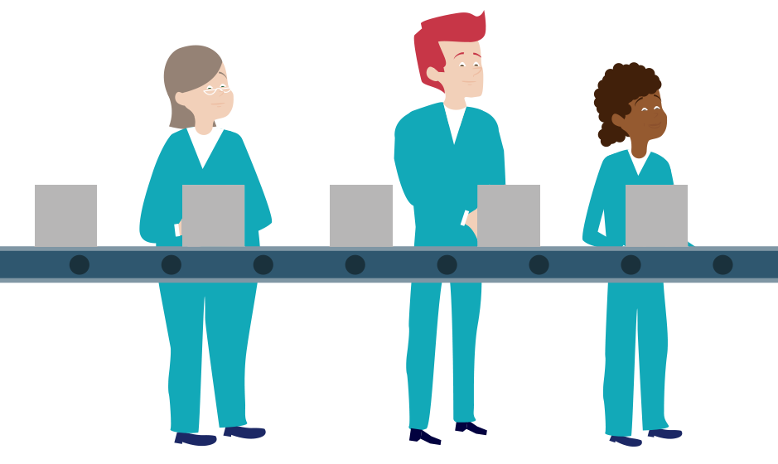
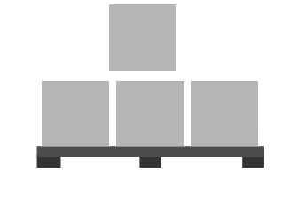
Tackling MSDs
MSDs are preventable and manageable
Integrated approach
and prevention culture
Actions based on
the general principles
of prevention
Notes:
MSDs are preventable and manageable.
Taking an integrated approach and promoting a culture of prevention are essential.
Actions to prevent or minimise MSDs should be based on the general principles of prevention:
avoid risks;
combat risks at source;
adapt work to the individual;
adapt to technological progress;
replace risky practices with safe or less risky practices;
develop a coherent prevention policy;
prioritise collective measures;
provide training and instruction for workers.

Slide 9
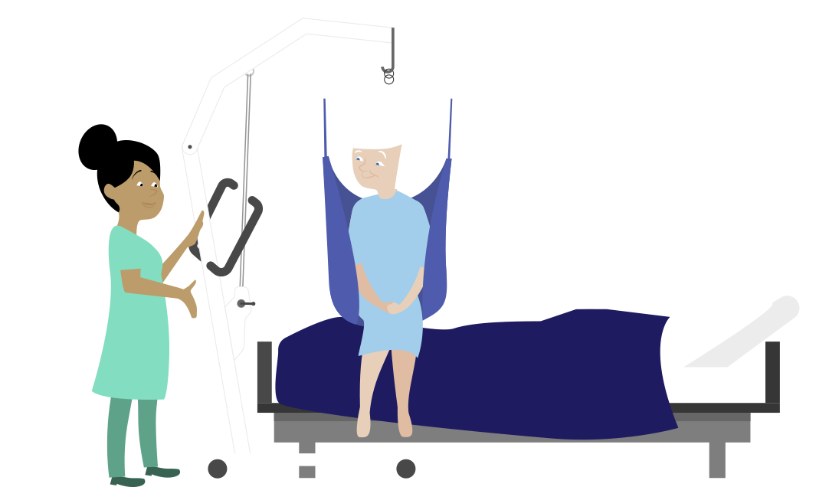
Risk assessment
Essential for successful prevention
Everyone — employers, managers, workers and OSH services — should participate
All groups of workers should
be covered
The process should be regularly revised and updated
Tools, instruments and step-by-step guidance available
Notes:
Risk assessment
Risk assessment is essential for successful prevention.
Everyone — employers, managers, workers and OSH services — should participate in identifying risks and ways of managing them.
All groups of workers should be covered.
The risk assessment process should be regularly revised and updated.
Tools, instruments and step-by-step guidance are available to help businesses carry out risk assessment.
Step-by-step risk assessment for work-related MSDs
Preparation:
Decide who will lead the risk assessment process.
Review all available information on MSDs in the company.
Assessment:
Identify risks and exposure.
Draw up an action plan based on principles of prevention, with preventive measures intended to eliminate MSD risks given top priority.
Implementation:
Implement agreed prevention and protective measures.

Slide 10
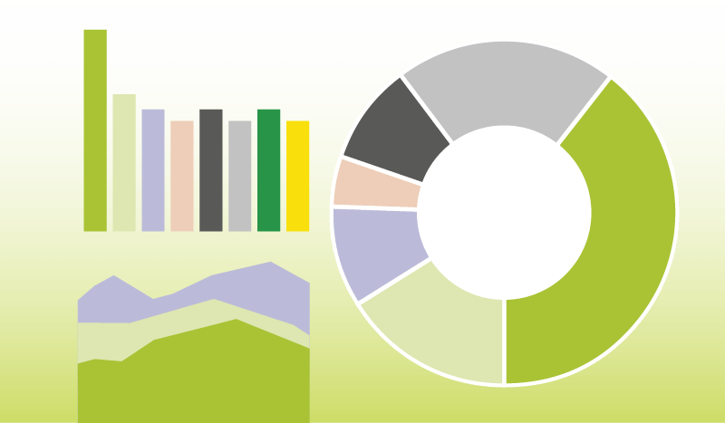
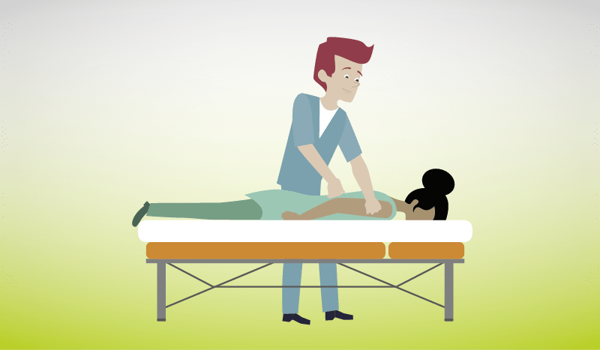


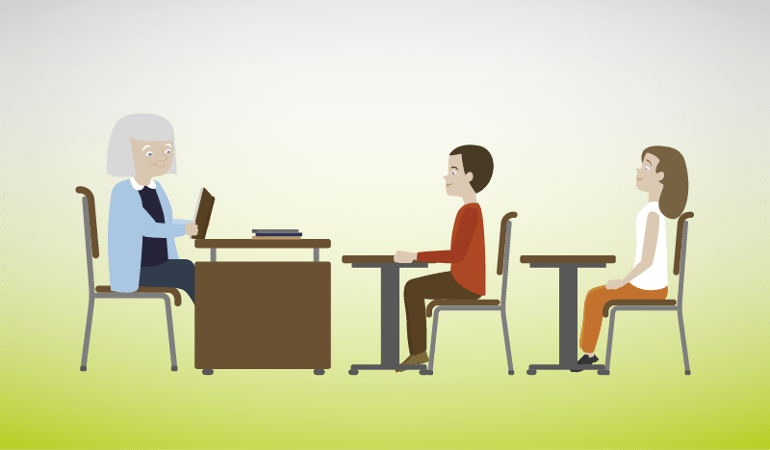

Areas of intervention – Priority areas
Facts and figures
Chronic conditions
Sedentary work
Worker diversity
Future generations
Psychosocial risks
Notes:
The ‘Healthy Workplaces Lighten the Load’ campaign is organised into several priority areas, which are being promoted via special communication and promotion packs spread over the full duration of the campaign. Each area looks at a specific topic related to MSDs. A range of materials, including reports, info sheets, infographics and case studies, are being released every three to four months in order to maintain the momentum of the campaign.
Facts and figures/business case
MSDs affect millions of workers in Europe and the businesses they work in. Prevention and early intervention measures can reduce absenteeism, increase productivity and lead to real savings for businesses, as well as national healthcare and social welfare systems. The campaign provides evidence of this and links to resources that can help businesses tackling MSDs effectively.
Chronic conditions
Early intervention is key to preventing MSDs from becoming chronic. If a worker already has a chronic condition, they can be supported through well-managed OSH interventions, which will ensure that the worker
can return to work and stay in work. Talking about MSDs in the workplace is crucial for success, and simple changes to the work environment or work organisation can:
significantly reduce sick leave and long-term absence from work;
Lead to tangible savings for businesses and national health and welfare systems.
Sedentary work
Sitting for prolonged periods is an issue encountered in many jobs, including work involving computers and assembly lines, and can increase the risk of developing MSDs and other health problems, for example obesity. It is therefore essential that measures are put in place to address this risk factor, such as encouraging workers to frequently change their posture and promoting the benefits of good workplace design.
In the context of confinement due to the COVID-19 pandemic, millions of European workers have been forced to work from home full-time to cut down the risk of contracting the virus. A new reality that can take its toll on our physical (including prolonged sitting) and mental health. Our brand new MSD database of practical tools and guidance makes it easy to assess and manage many MSD risks, including from telework. It contains links to resources from all across Europe: publications, case studies, guidance, practical tools, audio-visual materials.
Worker diversity
It is important that all workers are protected equally from exposure to MSD risk factors; however, some groups of workers — for instance women, older workers and migrant workers — are more likely to be exposed than others.
This may be because of a lack of training or because these groups are often over-represented in jobs or sectors associated with a higher risk of MSDs, such as:
agriculture
construction
health and social care work.
Prevention measures should therefore take into account the needs of these groups.
Future generations
Research findings indicate that even school children report musculoskeletal pain. To prevent young workers from entering the workplace with pre-existing MSDs that may be exacerbated by work, it is in everyone’s interest to raise awareness of the issue as early as possible. This campaign is an opportunity to promote good musculoskeletal heath among children and young people by:
mainstreaming MSD-related issues in the education sector/curriculum;
supporting public health initiatives encouraging physical activity inside and outside schools.
Psychosocial risks
When carrying out a risk assessment of MSD risks in the workplace, all factors need to be taken into account. This includes physical, organisational, psychosocial and individual factors. Psychosocial factors, such as a lack of control over workload, significantly contribute to exposure to work-related MSD risks.

Slide 11

COVID-19: MSDs and home-based telework
Prevalence of telework across the EU has risen and will continue to do so after COVID-19
Telework increases the risk of suffering from MSDs
Significant growth in MSD complaints among teleworkers during the pandemic
Associated MSD and psychosocial risk factors need to be addressed
Notes:
IES Working at Home Wellbeing Survey Interim Findings
https://www.employment-studies.co.uk/resource/ies-working-home-wellbeing-survey
https://www.employment-studies.co.uk/sites/default/files/resources/summarypdfs/IES%20Homeworker%20Wellbeing%20Survey%20Headlines%20-%20Interim%20Findings.pdf
“There has been a significant increase in musculoskeletal complaints. More than half of the survey respondents reported new aches and pains, especially in the neck (58 per cent), shoulder (56 per cent) and back (55 per cent), compared to their normal physical condition.” It is important to underline that these are just first findings based on a survey limited in terms of representation.
European Commission, Telework in the EU before and after the COVID-19: where we were, where we head to, https://ec.europa.eu/jrc/sites/jrcsh/files/jrc120945_policy_brief_-_covid_and_telework_final.pdf

Slide 12
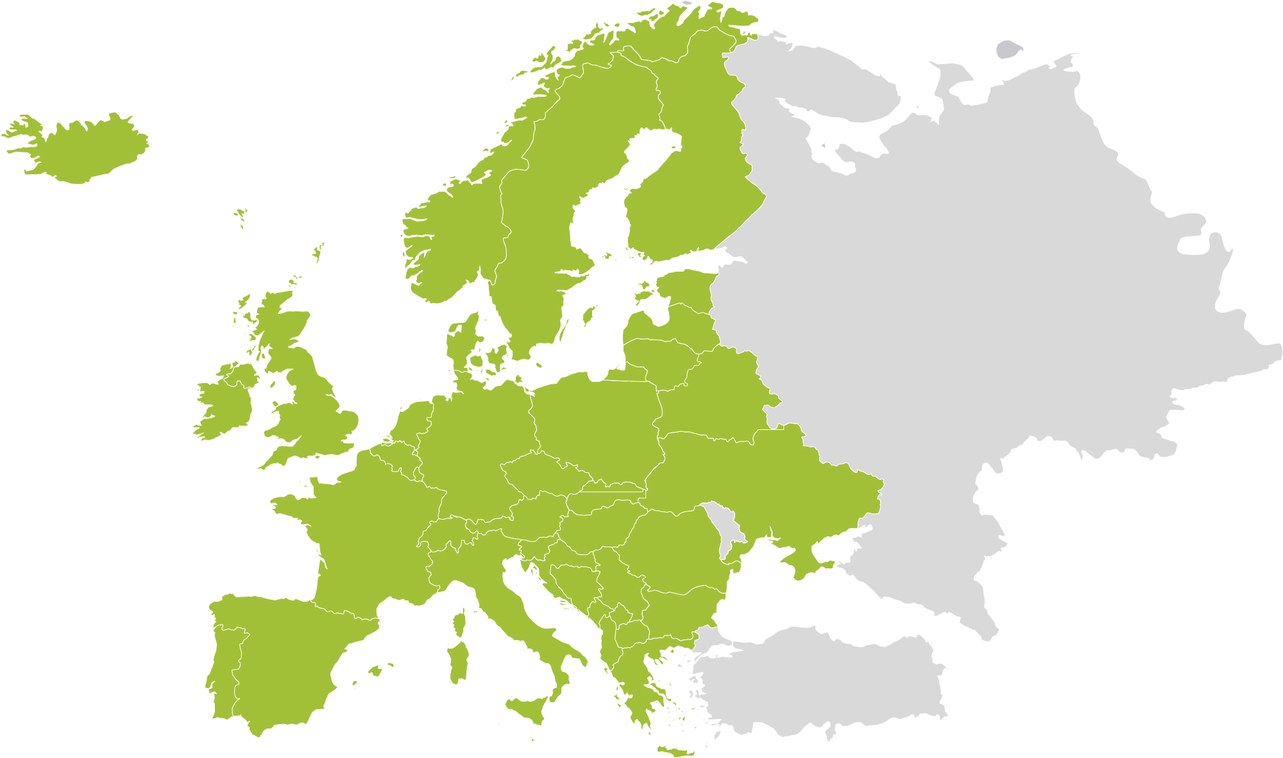

EU-OSHA and campaign partners
  MEDIA PARTNERS
  EUROPEAN SOCIAL PARTNERS
  EU AGENCIES
  EU INSTITUTIONS
NATIONAL FOCAL POINTS
  ENTERPRISE EUROPE NETWORK
  OFFICIAL CAMPAIGN PARTNERS
Notes:
The campaign is run by EU-OSHA, with the help of a network of partners in more than 30 countries, including:
national focal points
European social partners
official campaign partners
media partners
Enterprise Europe Network
EU institutions
other EU agencies.
The partners act as intermediaries between EU-OSHA and Europe’s workforce, disseminating campaign materials and resources at the national level. The dedication and active involvement of EU-OSHA’s partners drives the campaign and ensures that the campaign’s message is successfully promoted across Europe, reaching businesses of all sizes.

Slide 13
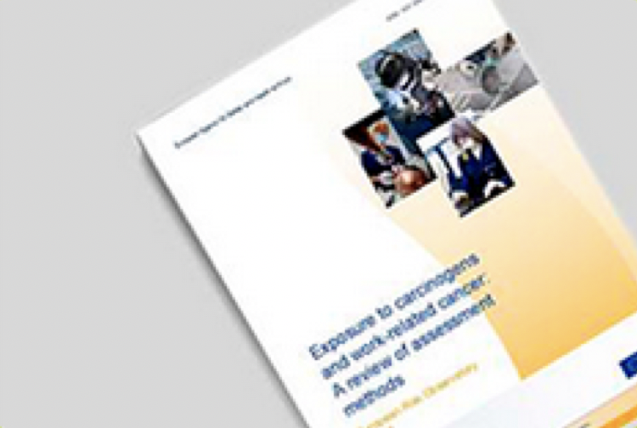



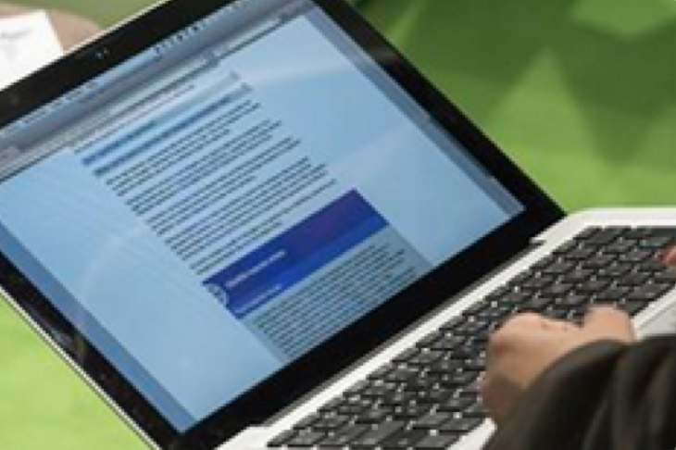


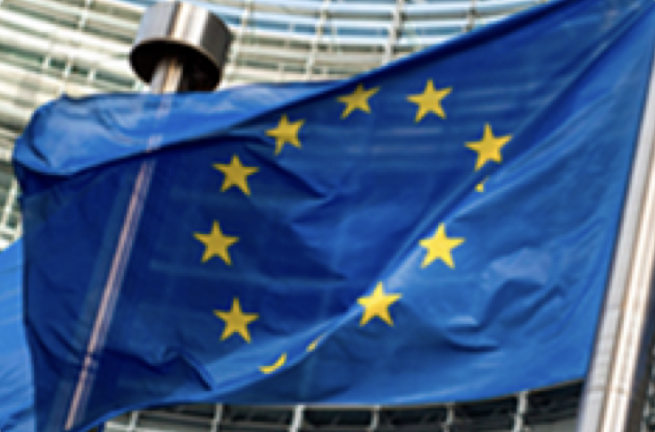
Campaign resources
Publications
Campaign material
Campaign toolkit
Napo films
OSHwiki
Practical tools
& guidance
Case studies
Legislation
Notes:
Publications
A number of research reports, summaries and info sheets on MSD-related risks are available and free to download. These publications can be used to inform preventive measures in the workplace.
Campaign material
The ‘Healthy Workplaces Lighten the Load’ campaign materials, such as the campaign guide and promotional leaflet, explain how the campaign works and how to get involved. They also clarify how the guidance provided can be implemented in the workplace.
Campaign toolkit
The campaign toolkit provides practical step-by-step advice on how to plan and run successful campaigns. It includes examples of different communication tools and offers tips on how best to use them.
Napo films
Several short awareness-raising films — featuring the cartoon hero Napo — have been created on the topic of MSDs. These are a great way to engage businesses and inform them about the campaign’s message.
OSHwiki
A section on the OSHwiki platform has been dedicated to MSDs. It contains relevant articles and links to more information on the topic, including how to manage a worker’s rehabilitation and return to work.
Practical tools and guidance
An easy-to-use database of practical tools and guidance has been created to help workplaces easily assess and manage MSD-related risks. The resources, which include visual materials, cover a wide range of sectors, hazard types and prevention measures.
Case studies
In addition to the case studies in the database, policy case studies from EU countries and outside the EU are also available. These case studies describe success factors and the transferability of national policy initiatives.
Legislation
The employer is legally responsible for ensuring workplace safety and health. MSD risks fall within the scope of the OSH Framework Directive (Directive 89/391/EEC — the OSH Framework Directive), and some are tackled specifically by the following directives:
Directive 90/269/EEC — the Manual Handling Directive
Directive 2002/44/EC — the Vibration Directive
Directive 90/270/EEC — the Display Screen Equipment Directive
Directive 2009/104/EC — the Use of Work Equipment Directive
A complete overview of relevant OSH legislation is available on the EU-OSHA website (https://osha.europa.eu/en/safety-and-health-legislation).

Slide 14
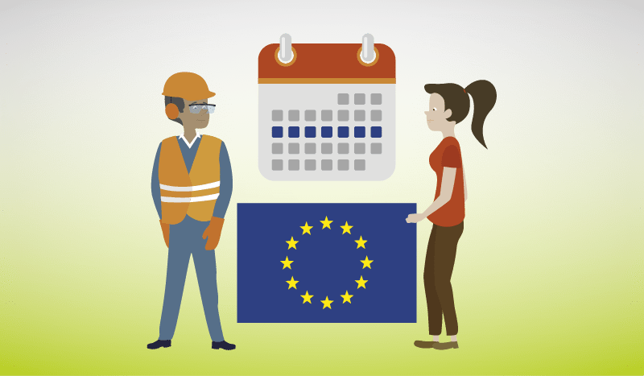




How to get involved
European Week
Campaign partnership
Good Practice Awards
Campaign toolkit
Campaign materials
Events
Certificate of participation
Notes:
European Week
Our world-renowned European Week of Safety and Health at Work is held every year in October and is the highlight of the campaign calendar. You can get involved in many awareness-raising events that are organised in the EU and beyond, such as competitions, special film-screening events, social media events and conferences.
Campaign partnership
The success of the campaign depends on strong partnerships between EU-OSHA and key stakeholders. Pan-European and international organisations with a commitment to OSH can become an official campaign partner, which allows them to benefit from:
promotion at EU level and in the media;
opportunities to network and exchange;
sharing good practice with other campaign partners;
invitations to EU-OSHA events;
a welcome pack;
a partner certificate.
Good Practice Awards
As part of the campaign, the Good Practice Awards showcase innovative approaches to OSH management and recognise successful and sustainable initiatives for managing work-related MSDs. Organisations in EU Member States, candidate countries, potential candidate countries and European Free Trade Association (EFTA) countries are invited to submit entries on the theme of managing MSDs in the workplace, and the winners will be announced at an awards ceremony.
Campaign toolkit
You can access our campaign toolkit to help you get started with running your own campaign to raise awareness of work-related MSDs. The toolkit offers step-by-step guidance on the process of preparing and running a campaign and how to make the most of your resources.
Campaign materials
Everything you need to promote and make a contribution to the ‘Healthy Workplaces Lighten the Load’ campaign is available in the campaign materials. A full range of resources are free to download, including the campaign guide, promotional leaflet and poster, and the Good Practice Awards flyer.
Events
You can view upcoming events of the ‘Healthy Workplaces Lighten the Load’ campaign. Events can be searched by country and by dates, and each event can be added to your own calendar to make sure you don’t miss out.
Certificate of participation
In return for organising events and activities or running your own campaign to support the Healthy Workplaces campaign, you will receive a certificate of participation in recognition of your efforts and contribution.

Slide 15






Join us and lighten the load!
Find out more on the campaign website:
  www.healthy-workplaces.eu
Subscribe to our campaign newsletter:
  https://healthy-workplaces.eu/en/healthy-workplaces-newsletter
Keep up to date with activities and events through social media:
Find out about events in your country from your national focal point:
  https://healthy-workplaces.eu/en/campaign-partners/national-focal-points
2020
October
CAMPAIGN LAUNCH
#EUhealthyworkplaces
Notes:
© European Agency for Safety and Health at Work, 2020
Reproduction is authorised provided the source is acknowledged.
For any use or reproduction of photos or other material that is not under the copyright of EU-OSHA, permission must be sought directly from the copyright holders.

